Slide 1

Grammar & BAsics
Tenses
Session 1

Slide 2

Course Set-up
Two sessions per week
1) Group Workshop
Explanation, discussion and practice of a grammatical topic
2) Work sessions (leerplein).
Open ended sessions with all groups:
- Work on self-study topics,
- Ask teachers questions about that week’s topics,
- Work on speaking (get feedback) or
- Work on writing/culture assignments.

Slide 3
Todays Topic: Verbs
Warm-up: Introduce yourself to your neighbour, using as many different tenses (types of verbs) as possible.
See how many different tenses you can work into your introduction.
Tenses?
One example of a tense is the present simple:
I love the latest season of that TV show!
These days, he cleans the house more often.
Not sure what to say? Talk about these topics!
favourite things / hobbies / ambitions / family / dislikes / what you’re reading / your morning / etc.

Slide 4

Grammatical Tenses
We use grammatical tenses to describe when an ACTION happened.
Three main tenses:
Past, Present, Future
Rest of the grammatical tenses are aspects of these three main tenses

Slide 5
Today we focus on:
The Present & The Past

Slide 6
Present Tenses Compared What is the difference in meaning?
Present Simple (3 types)
Present Continuous (4 types)
It rains a lot in the Netherlands.
The train leaves tonight at 10 PM.
He works hard most of the time.
They play tennis.
Water freezes at 0 degrees Celsius.
Close the door! It is freezing outside.
I am staying with some friends until I find a flat.
Shh! I am reading my book.
I am reading The Lord of the Rings for the third time.
I am meeting some friends after work.
She is always yelling in class.

Slide 7
Present simple – Usage I
Repeated actions
The train leaves every morning at 8 AM.
I go to the climbing gym every Sunday.
Facts or Generalizations
Water boils at 100 degrees celsius.
Dogs like playing fetch.
Scheduled events int he near future
When does class begin tomorrow?
The party starts at 8 o'clock.

Slide 8
Present simple – Usage II
I go to school every day.
She usually reads a book after dinner.
Signal words: every.., each, usually, every day,

Slide 9
Present Simple
Form:
I, you, we, they + verb → I work
he, she, it + verb + -s → he works
Exceptions
do and go: verb + -es →
he does, he goes
verbs ending in -s/-ss/-sh/-ch/x: verb + -es →
he kisses, he washes, he boxes
verbs ending in -y: -y → -ies →
he hurries, he studies, he tries
But -ay/-ey/-oy/-uy just get -s →
he plays, he enjoys, he buys

Slide 10
Present continuous – Usage
Now
You are learning English now.
He is running now.
Longer actions in progress now
Trump is running for president.
I am reading Dune.
Near Future
I am cycling to work tomorrow.
They are looking after the baby next weekend.
Repetition and irritation with always
He is always stomping down the stairs.
She is always eating with her mouth open.

Slide 11
Present Continuous
Form:
I + am + verb + -ing → I am working
he, she, it + is + verb + -ing → he is working
you, we, they + are + verb + -ing → you are working

Slide 12
Present Continuous - Spelling
Verbs ending in -ie (die, lie, tie): -ie → y →
I am dying, you are lying, he is tying
Verbs ending in vowel + consonant (stop, plan, rub) double the consonant →
I am stopping, you are planning, he is rubbing
verbs ending in -e (hope, dance, smile): leave out -e
I am hoping, you are dancing, he is smiling

Slide 13
Present continuous – signal words
Words indicating a current action:
(right) now, at the moment, look!, listen!
Words indicating a period around now:
today, this week, this year

Slide 14
Present Tenses Compared
Present Simple Rule
Present Continuous Rule
Facts and routines
Verb
Verb+S
Verb+ES
Action at the moment, in progress, unfinished
Am, is, are + Verb+ING

Slide 15
Practice! - Pairs
Describe an average day in your life Using the PRESENT SIMPLE only
Signal words:
Always
Every...
Normally
Sometimes
Regularly
Never
Often

Slide 16
Break

Slide 17
Present/Past Tenses Compared What is the difference in meaning?
Past Simple (4 types)
Present Perfect (2 types)
I lived in Groningen for 8 years.
They played the violin as a child.
It was at school last week.
He painted the door last week.
She broke her leg when she was 12.
First I woke up, then I had breakfast, and then I cycled to school.
I have lived in Utrecht for 6 years.
I have been at school since this morning.
I have already seen Dune, but I’d still like to go to the movies.
He has painted the door, so don’t touch it.
She has broken her leg and can’t walk for a while

Slide 18
Past Simple - Usage
Completed Action in the past
I saw a movie yesterday
That car looks dirty. Yeah, the last time I cleaned it was 4 months ago.
Series of actions
I finished work, walked to the beach, and found a nice place to swim.
Duration in the past
We waited for 5 hours.
Habit in the past (used to)
I studied Japanese when I was younger.

Slide 19
Present Perfect - Usage
Unspecified Time before now
I have been to Japan before
Ooow, you have grown so much since I last saw you.
Samir hasn’t arrived yet.
They have already scored 3 goals and it’s only half-time!
Duration from the past until now (and possibly continuing)
He has been ill for a week.
I have backpacked around Spain for a month now.

Slide 20
Present/Past Tenses Compared
Past Simple Rule
Present Perfect Rule
Completed action in past
Verb+ed
Irregular form of verb
Action started in past and noticable/still happening now
Have/has + past participle

Slide 21
Past simple - Spelling
The verbs that are regular sometimes also have changes in spelling
Verbs ending in vowel + consonant (stop, plan, rub) double the consonant →
I stopped, you planned, he rubbed
verbs ending in -e (hope, dance, smile): just add -d
he hoped, he danced, he smiled
verbs ending in -y: -y → -ied →
he hurried, he studied, he tried
But: he played, he enjoyed

Slide 22
Past simple - When
When there is an expression indicating past time
I worked at Hogeschool Rotterdam five years ago.
They went to school yesterday.
Shakespeare died in 1616.
I saw John 5 minutes ago.
To indicate that something is finished.
I lived in Groningen for 8 years.
He worked at that office for a couple of months.

Slide 23
Past simple – Signal words
Any expression indicating past time
Yesterday, earlier, … ago, last …, in (+ time in the past), when …, specific dates

Slide 24
Present Perfect – When I
I have worked at Hogeschool Utrecht for four years now.
He has lived in the Netherlands all his life.
Form:
I you, we, they + have + verb + -ed → I have worked
he, she, it + has + verb + -ed → he has worked
The spelling difficulties are the same as for the past forms (see slide 4)

Slide 25
Present Perfect – When II
Anything from the past until now that is not finished
I have lived in Utrecht for 6 years.
He has never been to Spain.
Also actions in the past that have a result now
I have forgotten her name (I still don’t remember it now).
She has lost her key (she still doesn’t have it now).
But: when the action is over and/or a time expression is used you use the past form
She lost her key, but she found it again.
She lost her key yesterday.
Notes:
Only true until it’s finished5
It’s a temporary job
Not necessarily at this very moment, but it’s a process that has started and not yet finished. It’s also of limited duration (you know it’s going to end)

Slide 26
Irregular forms
See book – Appendix list

Slide 27
Present Perfect – Signal words
Words indicating how long:
Since (+ moment in time) → since Monday, since June
For (+ duration) → for weeks, for 5 years
Only if it has not finished!
They lived there for 5 years, but then they moved away.

Slide 28
Past tenses - Review
We’ve already seen two forms to talk about the past
For things that are finished (past only) →
I worked there for 4 years
For things that are not finished (from past until now) →
I have worked there for 4 years
There are two other forms that are used, especially in combination with the normal past form

Slide 29
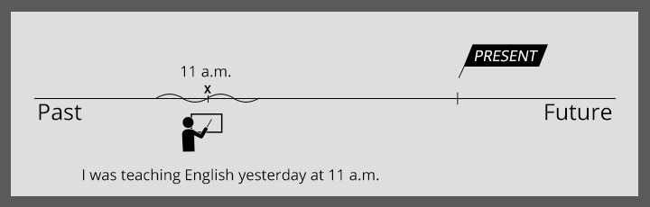
Past Tenses Compared
Past Continuous

Slide 30
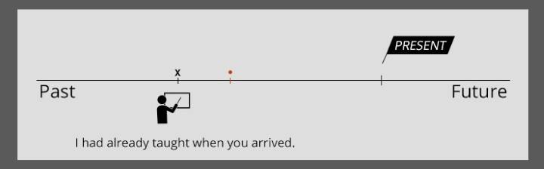
Past Tenses Compared
Past Perfect

Slide 31
Task: Identify the order of events
Identify the order:
I had called her before I heard she wasn’t home.
When the police arrived the thieves had left the building
The phone rang while I was having a bath
When the police arrived the thieves left the building
I was cutting the grass when suddenly I hurt my back.

Slide 32
Two things happening in the past One after another
Sometimes one event happens after another.
After I had left, he arrived.
I had called her before I heard she wasn’t home.
The event that happened first gets another form:
I, you, he, she, it, we, they + had + verb + ed → I had worked
See spelling rules/difficulties
Also many irregular forms (3rd column) → I had done

Slide 33
Two things happening in the past One after another
Often words like ‘before’ and ‘after’ also indicate the order
After I had left, he arrived.
I had called her before I heard she wasn’t home.
Not always the same order as the sentence
Before I found the ticket, the show had already begun

Slide 34
Two things happening in the past One after another
Sometimes you can only tell from the verb form which happened first
When the police arrived the thieves had left the building
(= the thieves had left before the police arrived)
When the police arrived the thieves left the building
(= the thieves left right before the police arrived)

Slide 35
Two things happening in the past At the same time
Sometimes two things in the past happened at the same time
Often one longer action interrupted by a shorter action
While I was having a bath the phone rang.
I was cutting the grass when suddenly I hurt my back.
You can also use them the other way around
When I saw Mike I was cycling home.

Slide 36
Longer actions in the past
Form:
I, he, she, it + was + verb + -ing → I was working
you, we, they + were + verb + -ing → you were working

Slide 37
Longer actions in the past
Besides using a phrase like ‘when I saw Mike’ we can also use expressions that indicate a time in the past
At 5 o’clock I was cycling home
Yesterday evening I was watching TV.
The form indicates that at that time you were in the middle of an action

Slide 38
Past Tenses Compared
Past Continuous
Past Perfect
Long action in the past interrupted by a short action in the past
Continuous actions in the past
Was/were + verb+ ing
One action in past before another action in the past
Had + past participle

Slide 39
Tenses Session 2
The Future

Slide 40
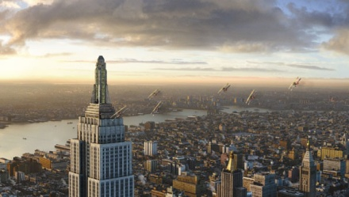



Future tenses Compared What is the difference in meaning?
I will travel to New York some day.
I am going to travel to New York this summer.
I am travelling to New York tomorrow.
My plane leaves at 15:00.

Slide 41
Future tenses Compared What is the difference in meaning?
I will travel to New York some day.
I am going to travel to New York this summer.
I am travelling to New York tomorrow.
My plane leaves at 15:00.
Prediction, neutral attitude
Plan, intention
Arrangement
Fixed in a timetable

Slide 42
Future tenses Compared What is the difference in meaning?
I will travel to New York some day. | Prediction, neutral attitude | Rule: will+ verb
I am going to travel to New York this summer. | Plan, intention | Rule: am/is/are going to + verb
I am travelling to New York tomorrow. | Arrangement | Rule: Am / is/ are verb+ing
My plane leaves at 15:00. | Fixed in a timetable | Rule: Verb+(ES)(S)

Slide 43
Talking about the future
In Dutch we often use the present form to talk about the future
In English you need to use a future form
The most common form is:
I/you/he/she/it/we/they + will + verb → I will work

Slide 44
FutureTenses Compared What is the difference in meaning?
Oh, I‘ll buy some chocolate on my way there.
(I think/I hope) I‘ll have so much fun this weekend.
I think he’ll fail.
I‘m going to buy some chocolate on my way there.
I‘m going to have so much fun this weekend.
He didn’t study. He’s going to fail.

Slide 45
Will is used
As a neutral way to talk about the future
We will meet again next week.
I will see you later.
For predictions
(I think) Hillary Clinton will run for president.
Tomorrow will be rainy.
For decisions made at the moment of speaking
[phone ringing] I will get it.
John called. Ok, I will call him back.

Slide 46
Talking about the future
Another common way to talk about the future is the following form:
I am going to + verb → I am going to do
he, she, it is going to + verb → he is going to do
you, we, they are going to + verb → we are going to do

Slide 47
‘Going to’ is used:
For plans and intentions
I’m going to buy a new car.
We are going to visit my sister on Monday.
When there are signs of something happening
Look at the clouds. It‘s going to rain.
That vase is tipping on the edge of that shelf. It’s going to fall down.

Slide 48
Present forms to talk about the future
In some cases you can use a present form to talk about the future
Instead of I ‘m going to do you can also use I am doing when talking about plans and intentions
Especially if you have already made the arrangements
We are flying to Australia tomorrow.
I am seeing my dentist next Tuesday
Make sure to add a reference to the future (tomorrow, next …, etc.) to avoid confusion

Slide 49
Present forms to talk about the future
The present form without -ing (I work) is not used often to talk about the future
It is used when talking about things that are fixed in a schedule or timetable
The autumn break starts on October 20th.
Their plane arrives at 10:15

Slide 50
Break

